Slide 1
Common Cents Budgeting
Denise G. Dias, M.S.
Johnson County Extension Agent
Family & Consumer Sciences

Slide 2
Zoom Etiquette
Please mute your microphone
Please stop your video to conserve bandwidth.
Use the chat box for comments and questions.
We will pause after the first half to answer questions.

Slide 3
Planning to Stay Ahead
Spending plan
Stretch Dollars
Goals for your income
Spend wisely
Focus on saving

Slide 4
Would a Spending Plan Help You?
Yes | No
 |  | Is your money gone before you get more?
 |  | Do you often wonder where your money was spent?
 |  | Do you run out of gas for your car or food?
 |  | Do you receive Collection notices for past due bills?
 |  | Do you dream about buying something but think you can never afford it?
 |  | Do you pay some of your bills late each month?
 |  | Do you borrow money or food from family, friends, or agencies to make ends meet each month?

Slide 5
Making a spending plan
Know how much money you have coming each month
Look at how you spend your money
Plan to save
Goals for yourself and your family

Slide 6
What money and other resources do you have?
Regular Money Income
Resources other than Money
Wages and Salaries
Tips/Commissions/Overtime
Social Security & Pensions
Child Support & Alimony
Unemployment Compensation
Family Investment Program
Supplemental Security Income (SSI)
Veteran’s Benefits
Children’s wages
Medical Assistance/Medicaid
Earned Income Credit (taxes)
WIC Coupons (Women, Infants and Children)
SNAP Benefits (Food Stamps)
Free or reduced school breakfast or lunch
Meals at Head Start or Daycare
Food Pantries/Meal Sites
Food from gardens (family, friends or other)
Free Clothing/Furniture/Baby Goods
Daycare assistance
Energy Assistance
Housing Assistance (LIEAP)
Other____________

Slide 7
Where does your money go?
Track with phone or wallet tracking sheet
Track all expenses for at least a month
Compare what is coming in with what is going out!

Slide 8
How can you increase income?
Drive for Uber or Lyft
Take paid surveys online
Answer professional questions
Sell used items online
Conduct a webinar
Build a simple sales funnel (automated selling machine)
Do Social media marketing for businesses
Start up a side hustle business
Rent out your home as a vacation rental
Use Fiverr to source gigs (web design, blogs, ghostwriting, accounting)
Play video games on Twitch
Create tutorials on YouTube
Other ideas???

Slide 9
How can you decrease spending or save money?
Go cash only/Envelope System
Freeze your credit cards
24 hour rule for purchases
Have no spend days
Make savings a game
Use discount codes and coupons
One in/one out rule
Remove your credit cards from online accounts
Cancel subscriptions you are not using
Set a per use spending limit
Link saving with splurging
Plan free activities
Accountability buddy
Other ideas???

Slide 10
Once a Year Expenses
School supplies
Vacation
Taxes
Insurance
Heating bills
Holiday, birthday and other gifts
Car tags
Medical Expenses
Other ideas???

Slide 11
Planning for Emergencies
Rainy Day Fund
Car Accident
Stolen Property
Illness
Car Repair
Set aside a special emergency fund
Start with $2/week = $100/year

Slide 12
Paying Bills
Decide
Decide who is paying the bills
Open
Open a bill as soon as it comes in
Pay
Pay bills on time
Send
Never send cash in the mail
Get
Get a receipt
Keep
Keep receipts for large expenses

Slide 13
Pause for Questions

Slide 14
Getting Credit
On time payments
Taking out a small secured loan
Pay back loan as agreed upon
Secured credit card with a low credit limit
Lenders look at your credit history to determine if you are a good credit risk
Cost of credit is interest, finance charges and tying up money you will earn in the future

Slide 15
Using Credit Wisely
Cost of item= payments + interest
Can you afford the payment if your income changes?
Save first, instead of borrowing (all or part)
Shop around to save money (APR)
Take the shortest loan possible, making larger monthly payments

Slide 16
Check your Credit
Free email program
Sends you reminders to check your credit with one of the three credit bureaus throughout the year.
2/2, 6/6, 10/10
Get info on how to read & understand your report
Correct errors
Utilize your credit report to your advantage
www.bit.ly/kscreditcheckyourcredit

Slide 17
What if you are in over your head?
Don’t ignore the problem
Talk to your creditors
Make a realistic payment plan and see if they will agree
Get the name and title of the person, make a note of date and time of conversation.
Put everything in writing!!!

Slide 18
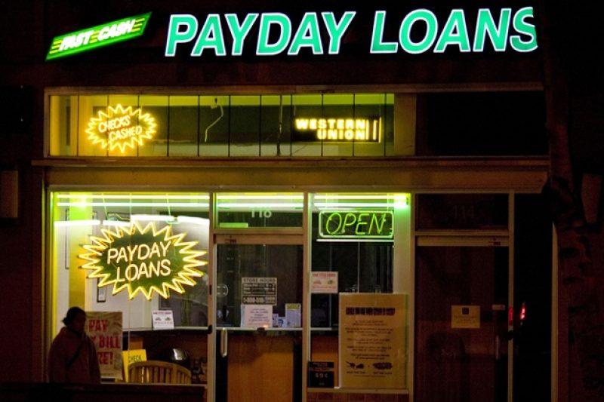
Payday Loans
Expensive way to get cash
Pay fees and interest
Required by law to tell you the cost of the loan
May seem convenient, they put you further into debt
Check out cost of a loan at other banks or credit unions first.
Check out the APR on your credit card first
If bill is with a utility company, check with them for emergency assistance programs
Ask creditors for more time and what the late charge is.
Seek debt counseling – there is local help available

Slide 19
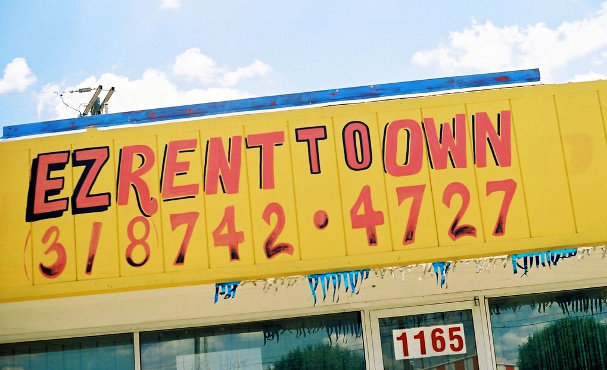
Rent to Own
Consumers beware!!!
What is the total cost?
When will you own the item?
Will the item be used or new?
What is your responsibility for damage or repair?
What if you make a late payment?
Saving first or Layaway will save you more money

Slide 20
Adding up the Extras:
Item | Price | Amount Purchased | Cost in a Month | Cost in a Year
Pop/candy bar | $1.99/ 20 oz. | 1 per day | $59.70 | $726.35
Cigarettes | KS $5.83+1.29tx $7.12/pack | 1 per day | $213.60 | $2,598.80
Fast food | $7.00/meal | 1per day | $210.00 | $2,555.00
Beer/Liquor | $10.49/12 pack Bud Light | 1/week 3/week | $41.96 $125.88 | $545.48 $1,646.44
Lottery Tickets | $3.00 (average) | 2/week | $24.00 | $312.00
Movies | $13.50/adult w/soda+pcrn $7 | 1/month–2 adlts | $41.00 | $492.00
Late Fees | $40.00 | 2-5 credit cards | $80.00 $200.00 | $960.00 $2,400.00

Slide 21
Tax Credits
Earned Income Credit
Homestead Credit
Seek assistance to prepare your taxes with free services such as VITA (Volunteer Income Tax Assistance Program)

Slide 22
Ways to Decrease Expenses: Grocery Shopping
40% of the food you buy is thrown away!
Average amount spent on food/week in KS $140 - $200
Savings per week…$56 - $80 per year…$2,912 -$10,400
Look for Ads and Coupons
Make a list and stick to it
Shop once a week
Shop by yourself when you are not hungry
Compare brands and quality
Choose cooking over convenience
Spend mostly on healthy foods, not junk
Non food items often cost more at supermarkets
JoCoEats (Easy Affordable Tasty Solutions)

Slide 23
Reduce Utility Bills
Ask about winterization programs
Weather-strip & Caulk
Raise your thermostat in warm weather at night and when no one is home
Consider installing a programmable thermostate to save when you are not home
Use hot water wisely
Turn off lights in unused rooms
Turn off TV and radio when not in use
Shop around for phone plans

Slide 24
Lower the Cost of Having Fun
Check Facebook for local events
Look for local activity guides
Borrow books, tapes, videos, music, games and more from the library.
Choose a cheaper plan for cable/TV streaming services
Plan parties and potlucks at home
Other ideas???

Slide 25
Keep Transportation Costs Down
Ride the Bus
Carpool/share a ride
Keep up with regular maintenance on your car
Group errands together
Check your tires!
Compare insurance coverage
Bicycle or walk to nearby places

Slide 26
Keep Clothing Costs Down
Buy off season
Buy at resale shops or garage sales
Trade clothes with other families
Give teens a budget & encourage them to earn money for more expensive items
Buy machine washable clothes (avoid dry cleaning)
Other ideas???

Slide 27
Resources you can use
K-State Extension Website
https://www.k-state.edu/family-finances
When Money Drops Publication Series
K-State Essential Skills/Money Management
www.bit.ly/kscreditcheckyourcredit
Power Pay Debt – University of Utah Extension
Phone Apps – Mint, Spending Tracker, Wallet, etc.
Envelope Cash Management – App version: Mvelopes
Money Smart KC – sponsored by Federal Reserve

Slide 28
JCPRD will send out online survey

Slide 29
Thank You!
Denise G. Dias, M.S.
K-State Research & Extension
Johnson County Agent
Family & Consumer Sciences
11811 S. Sunset Drive, Suite 1500
Olathe, KS 66061
913-715-7000
denise.dias@jocogov.org

